Slide 1
Why a new software architecture?
Motivations/means
Facilitate hardware development and evolution by focusing on atomic functionalities
Make software more stable and easier to maintain by decoupling system logic from hardware components
Better expose user interface by separating system low-level functionalities from high-level user oriented functionalities

Slide 2
Proposal in a nutshell
Interface with external world
OhmPi
load_sequence, set_sequence,
run_sequence, quit...
System
OhmPiHardware
vab_square_wave, readings,
pulses, sp...
Raspberry pi 3
mux.2024.0.0
Hardware components
TX, RX, MUX, Controller
mb.2024.0.0
mb.2023.0.0
...

Slide 3
Proposed architecture in 3 layers
Hardware components: TX, RX, MUX, Controller
each component should have minimal functionalities (e.g. RX should expose a method to read a voltage). The way it is done is coded in the RX class.
Hardware system: “Hardware OhmPi” assembled
an assembled OhmPi should be capable to perform atomic operations regardless of the hardware components used (e.g. create a voltage pulse and read current and voltage during the pulse). The way it is done is coded in the OhmPiHardware class.
System Interface with the external world “OhmPi”
interface providing high-level operations (e.g. acquire a seqence, react to remote commands…). The way it is done is coded in the OhmPi class.

Slide 4
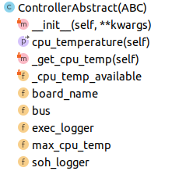
Minimal Controller

Slide 5
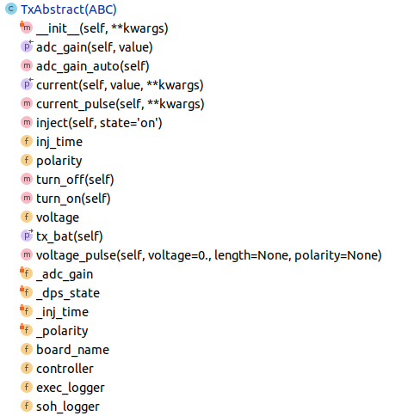
Minimal TX

Slide 6
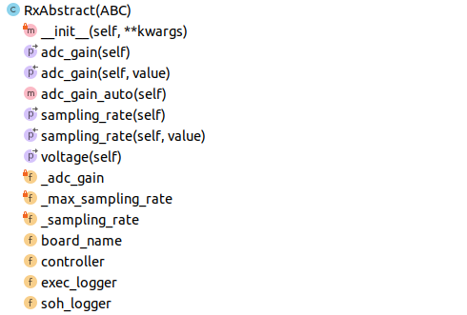
Minimal RX

Slide 7
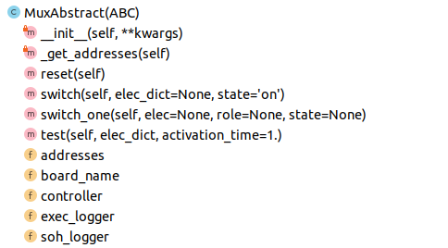
Minimal MUX
inner_cabling:
{(mux_connector, mux_role): {hardware switching params (e.g., cmp, gpio…)}, …}
self._addresses converts mux_connector to electrode and mux_role to array_role

Slide 8
System: OhmPiHardware
Cabling : {(elec_nr, role): (mux_name, mux_connector), ...}
Muxes are as autonomous as possible (in order to easily mix different types of muxes
or be tested/operated outside of a system) → check switching is ok at mux level
Each mux should be informed of which part of the system it is connected to but only
the system is aware of all the muxes
The system should also provide checks →check switching is ok at system level?

